Slide 1
Edinburgh
Lesya Zayda
9 – A

Slide 2
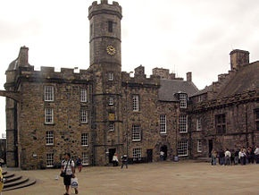
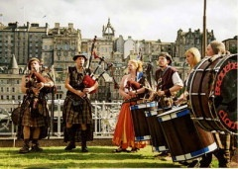
The capital of Scotland is famous for Edinburgh Castle, Royal Mile shops and summer art festivals.

Slide 3
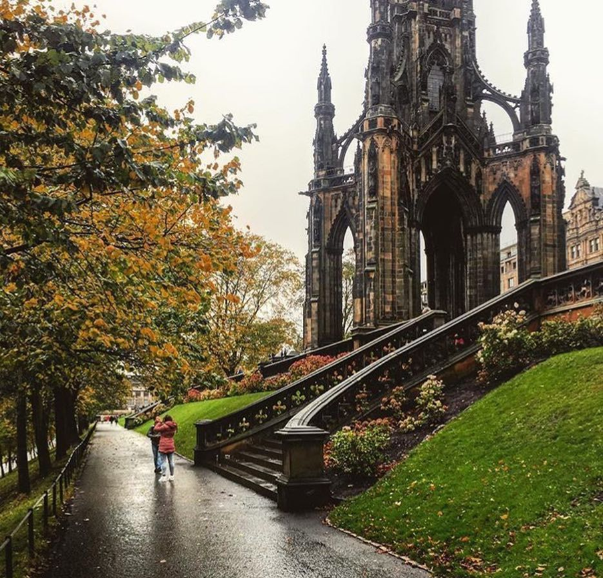
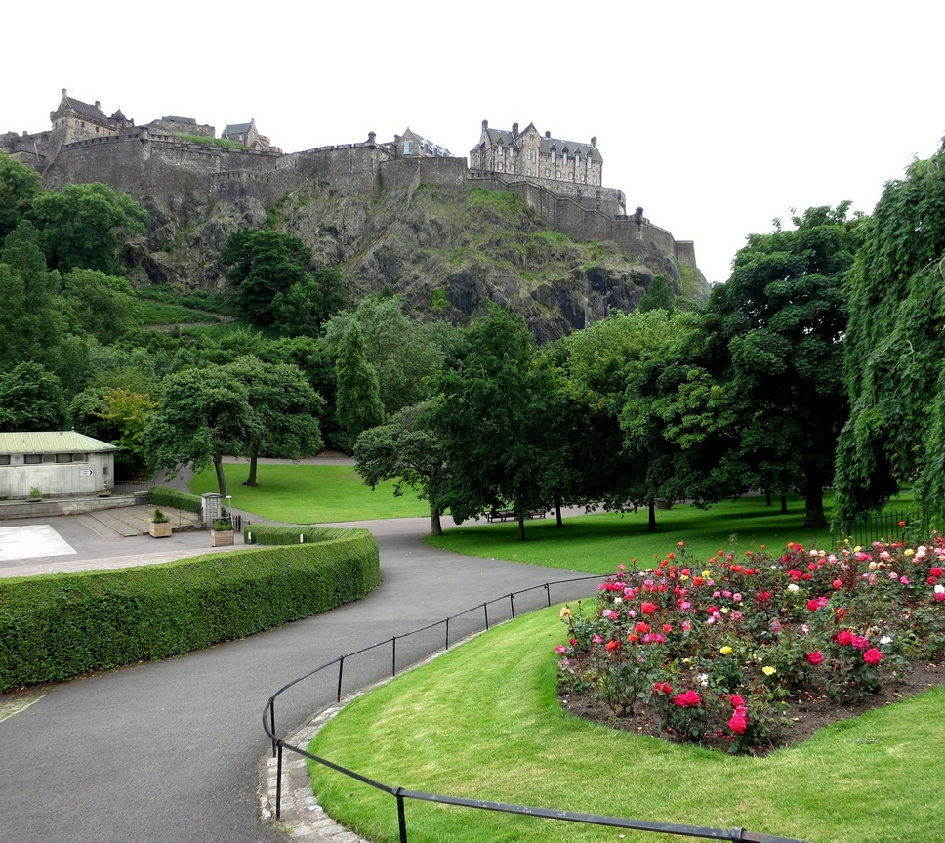
Edinburgh has never had an industrial plant, that’s why the air here is incredibly clean.
There are 112 parks in Edinburgh. It has more trees than in any other towns in the UK.

Slide 4
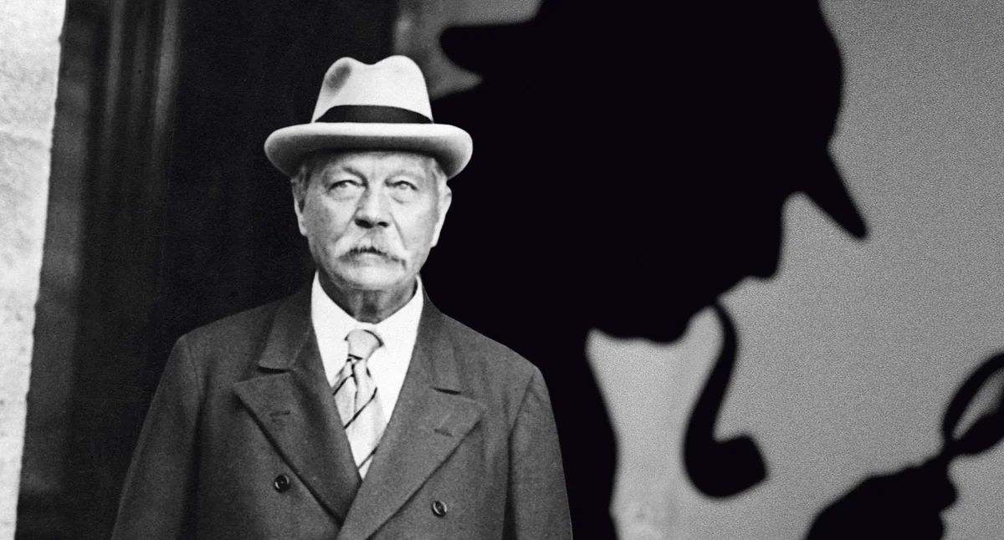
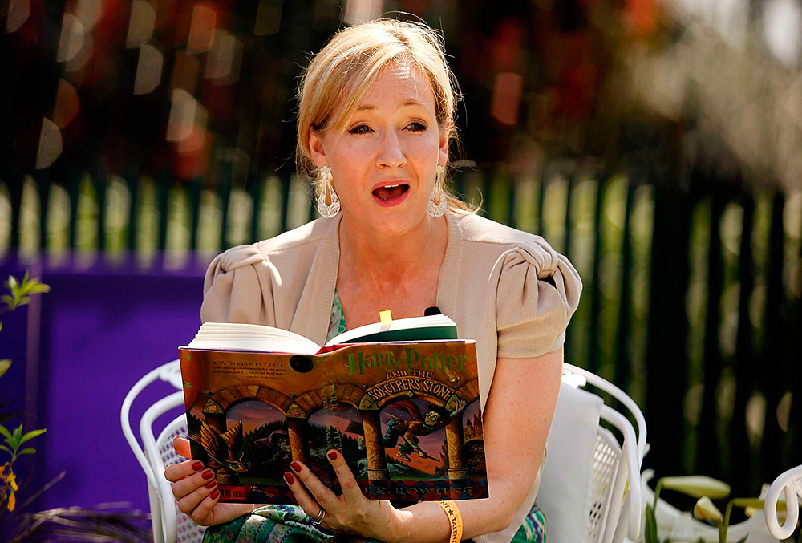
Sir Arthur Conan Doyle the author of Sherlock Holmes was born here.
Some people say that the character of Sherlock Holmes was similar the character of his university teacher Joseph Bell.
The first book about Harry Potter was written by Joan Rowling in this city.

Slide 5
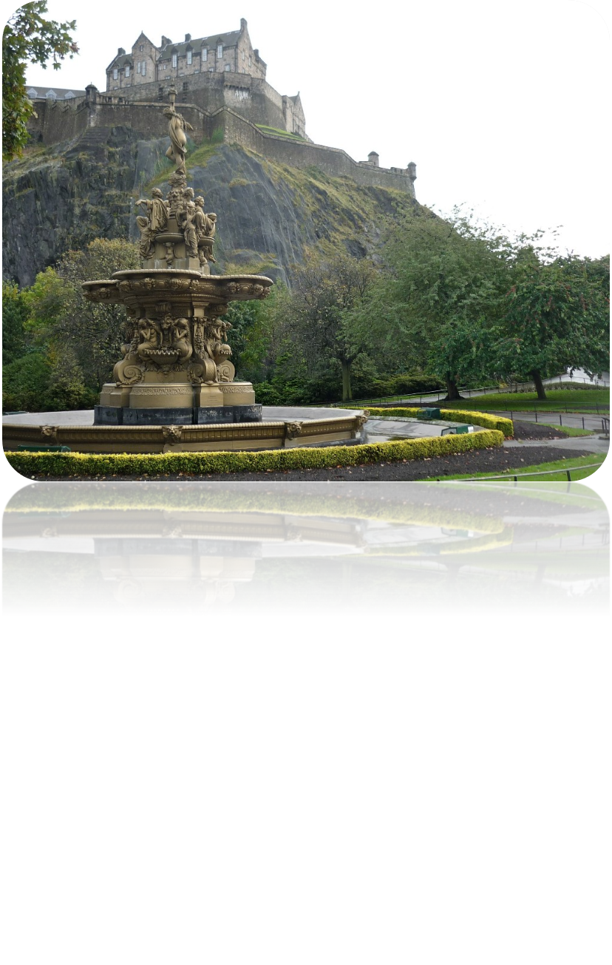
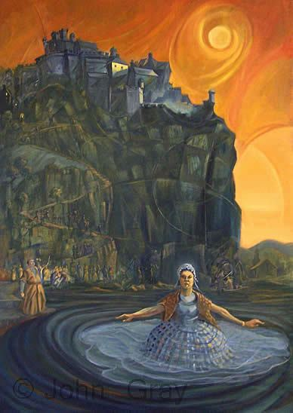
Many tourists like visiting Princes Street Gardens. There was Lake Nor Loch, the site of the executions of hundreds of witches in the past. Women were thrown into Lake Nor-Loch tied to chairs, and if they came to the surface, they were unconditionally considered witches and were executed accordingly. Well, if they drowned, they were found not guilty, but posthumously.

Slide 6
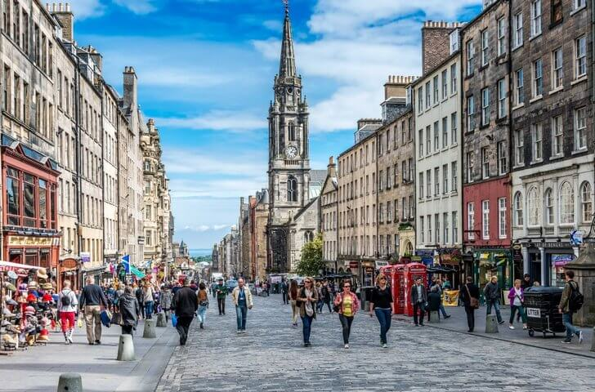
Edinburgh has more architectural monuments and cultural heritage sites than anywhere else in the world. There are about 16,000 historic buildings of different eras in the city.

Slide 7
Thanks for your attention!

