Slide 1
Glasgow
— Scotland’s largest city on the River Clyde in the Scottish Western Lowlands.
Virych Ksenia
9-A form

Slide 2
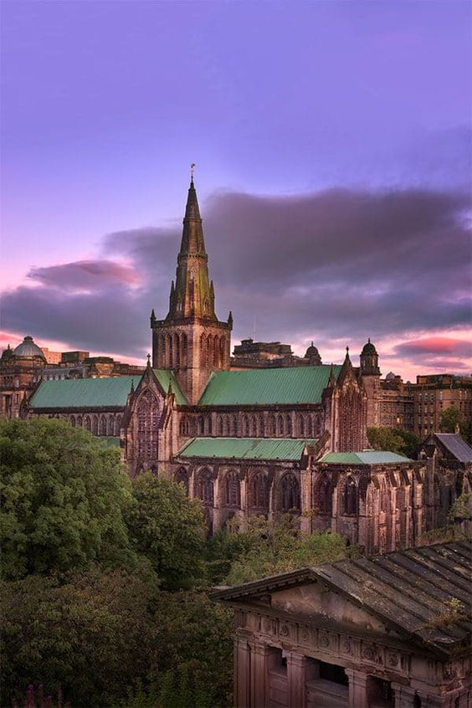
Glasgow, west-central Scotland.
It is situated along both banks of the River Clyde 20 miles (32 km) from that river’s mouth on the western, or Atlantic, coast.
Glasgow is Scotland’s largest city, and it forms an independent council area that lies entirely within the historic county of Lanarkshire.
The city occupies much of the lower Clyde valley, and its suburbs extend into surrounding districts.

Slide 3
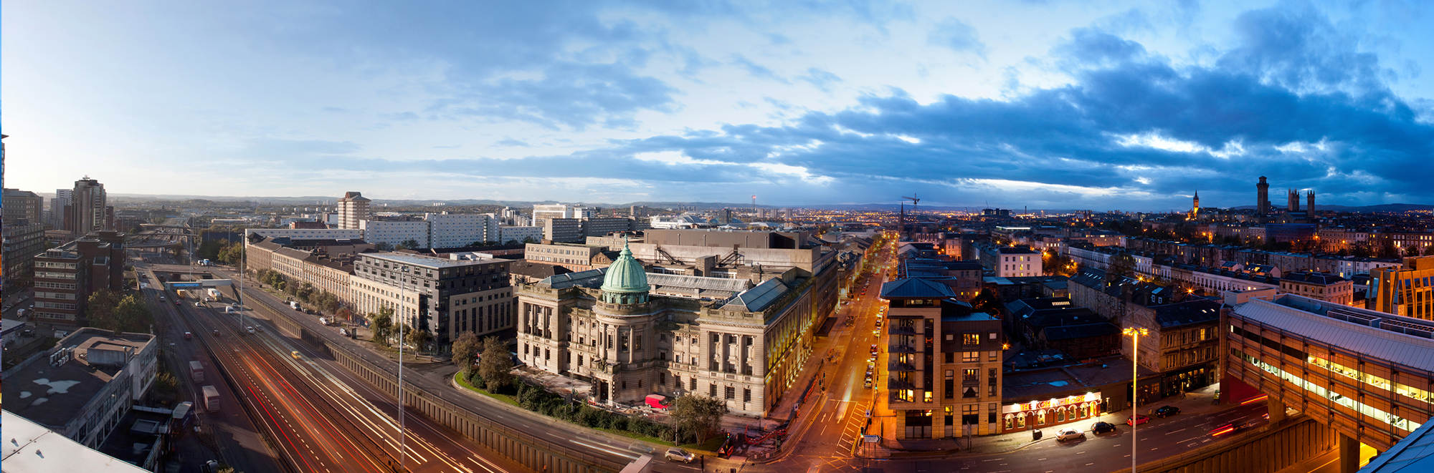
Glasgow was rated the top place for concerts in the UK outside of London, with eight venues in the Top 100 list of places to watch gigs.

Slide 4
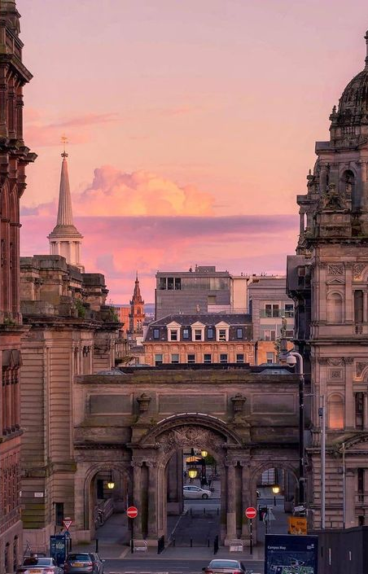
The Malmaison Glasgow hotel, located in the city centre, was once St Judes; a Greek Orthodox Church designed by architect John Stephen in 1838. It’s been a Malmaison since 1994.

Slide 5
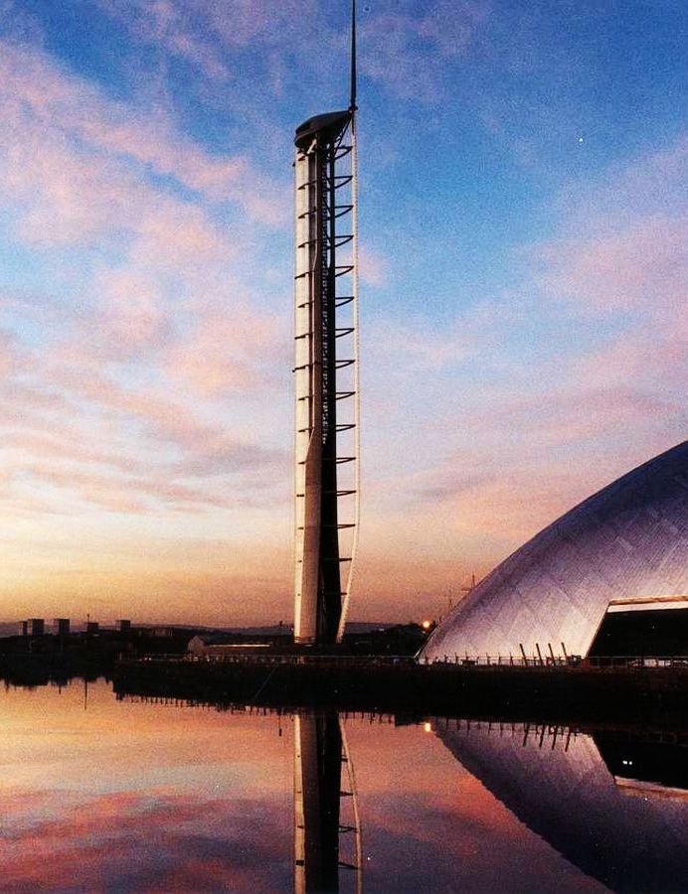
The Glasgow Tower is the only structure on Earth that has the ability to rotate 360 degrees into prevailing wind and it holds the Guinness World Record for tallest fully rotating freestanding structure in the world.
The tower has been besieged by problems since it was built in 2001, but opened to the public again in July 2014 with new safety features and an updated interior.

Slide 6
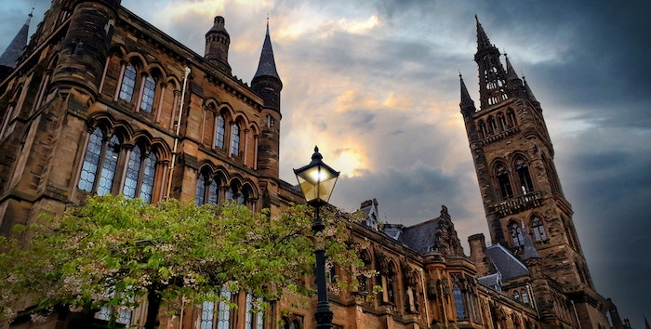
The University of Glasgow’s Hunterian Museum was built in 1807 and is Scotland’s oldest public museum. The museum has a large collection of art and scientific relics including the world’s first-ever ultra sound machine.

